Slide 1
S Specific Be specific in targeting an objective
M Measurable Establish a measurable indicator(s) of progress
A Assignable Make the objective assignable to one person for completion
R Realistic State what can realistically be done with available resources
T Time related
Characteristics of Objectives

Slide 2
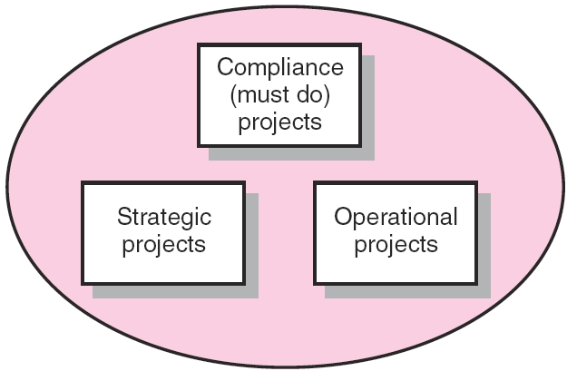
Portfolio of Projects by Type
FIGURE 2.2

Slide 3
A model for managing project
The concept Stage
  Someone identified a need for something
Develop a Problem Statement
  A project is a problem scheduled for solution
Generate Alternative Project Strategies
  There is more than one way to skin a cat. means that there are multiple methods to achieve a single goal.
Select and Evaluate the Strategy
  All P, C, T,S Requirements Met?
    Will it do the job?
  Are identified Risks Acceptable?
  Are consequences Acceptable?
  Does it Pass a Force Field Analysis?

Slide 4
Project Selection and Criteria of Choice
Choice Criteria
Realism
Capability
Flexibility
Ease of Use
Cost
Easy Computerization

Slide 5
P - Performance or Purpose: Does the proposed strategy fulfill the intended purpose or achieve the desired performance goals?
C - Cost or Capacity: Is the strategy within budget? Do you have the necessary capacity, resources, and funding to execute it?
T - Time or Timeline: Can the strategy be completed within the required timeframe or schedule?
S - Scope or Stakeholders: Does the strategy address all aspects of the project's scope, and does it align with the needs and expectations of the key stakeholders?
The image shows a series of questions under "Select and Evaluate the Strategy" that support this interpretation:
"Will it do the job?" relates to Performance or Purpose.
"Are identified Risks Acceptable?" and "Are consequences Acceptable?" relate to the overall viability and alignment with Stakeholders and the project's constraints (C and T).
"Does it Pass a Force Field Analysis?" is a tool used to analyze the driving forces (positive) and restraining forces (negative) of a proposed change or strategy, which again relates to evaluating the P, C, T, S factors.

Slide 6
Nonnumeric Models
Sacred Cow - project is suggested by a senior and powerful official in the organization
Operating Necessity - the project is required to keep the system running
Competitive Necessity - project is necessary to sustain a competitive position
Product Line Extension - projects are judged on how they fit with current product line, fill a gap, strengthen a weak link, or extend the line in a new desirable way.
Comparative Benefit Model - several projects are considered and the one with the most benefit to the firm is selected

Slide 7
Numeric Models:Profit/Profitability
  Payback period - initial fixed investment/estimated annual cash inflows from the project
  Average Rate of Return - average annual profit/average investment
  Discounted Cash Flow - Present Value Method
  Internal Rate of Return - Finds rate of return that equates present value of inflows and outflows
  Profitability Index - NPV of all future expected cash flows/initial cash investment

Slide 8
Numeric Models: Scoring
Unweighted 0-1 Factor Scoring Model
Weighted Factor Scoring Model

Slide 9
A Portfolio Management System
Selection Criteria
  Financial: payback, net present value (NPV), internal rate of return (IRR)
  Non-financial: projects of strategic importance to the firm.
Multi-Weighted Scoring Models
  Use several weighted selection criteria to evaluate project proposals.

Slide 10
Financial Models
The Payback Model
  Measures the time it will take to recover the project investment.
  Shorter paybacks are more desirable.
  Emphasizes cash flows, a key factor in business.
  Limitations of payback:
    Ignores the time value of money.
    Assumes cash inflows for the investment period (and not beyond).
    Does not consider profitability.

Slide 11
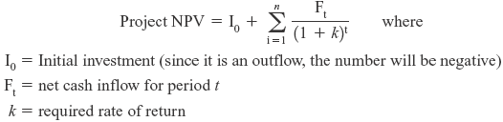
Financial Models (cont’d)
The Net Present Value (NPV) Model
  Uses management’s minimum desired rate-of-return (discount rate) to compute the present value of all net cash inflows.
    Positive NPV: the project meets the minimum desired rate of return and is eligible for further consideration.
    Negative NPV: project is rejected.

Slide 12
I0​ is the initial investment (a one-time outflow, so this value is typically negative).
FtF_tFt​ is the net cash inflow in period t. This represents the money that comes in during each period (e.g., year, quarter, etc.).
k is the required rate of return (also called the discount rate). This is the minimum return that investors expect from the project.
nnn is the number of periods (the total number of time periods over which the project runs).
t is the specific period (for example, t=1t = 1t=1 could represent the first year, t=2t = 2t=2 the second year, etc.).

Slide 13
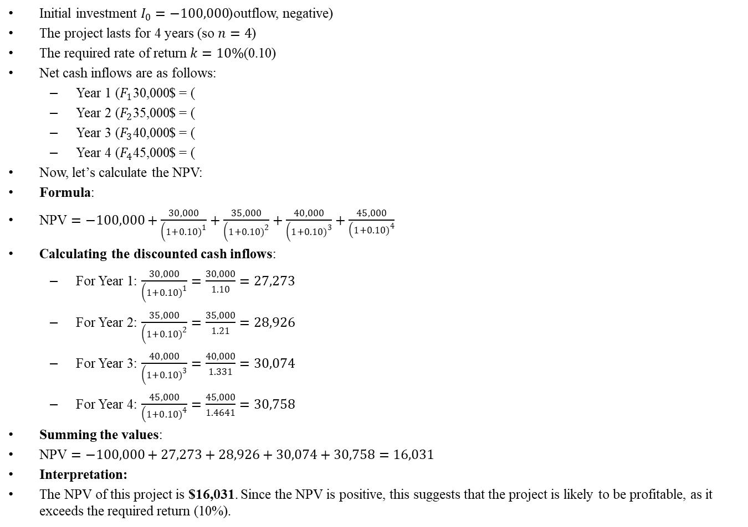
Initial investment $I_{0}=−100,000$(outflow, negative)
The project lasts for 4 years (so $n=4$)
The required rate of return $k=10\%$(0.10)
Net cash inflows are as follows:
  Year 1 ($F_{1}$) = $30,000
  Year 2 ($F_{2}$) = $35,000
  Year 3 ($F_{3}$) = $40,000
  Year 4 ($F_{4}$) = $45,000
Now, let’s calculate the NPV:
Formula:
$\text{NPV}=−100,000+\frac{30,000}{\left(1+0.10{\left.)\right.}^{1}\right.}+\frac{35,000}{\left(1+0.10{\left.)\right.}^{2}\right.}+\frac{40,000}{\left(1+0.10{\left.)\right.}^{3}\right.}+\frac{45,000}{\left(1+0.10{\left.)\right.}^{4}\right.}$
Calculating the discounted cash inflows:
  For Year 1: $\frac{30,000}{\left(1+0.10{\left.)\right.}^{1}\right.}=\frac{30,000}{1.10}=27,273$
  For Year 2: $\frac{35,000}{\left(1+0.10{\left.)\right.}^{2}\right.}=\frac{35,000}{1.21}=28,926$
  For Year 3: $\frac{40,000}{\left(1+0.10{\left.)\right.}^{3}\right.}=\frac{40,000}{1.331}=30,074$
  For Year 4: $\frac{45,000}{\left(1+0.10{\left.)\right.}^{4}\right.}=\frac{45,000}{1.4641}=30,758$
Summing the values:
$\text{NPV}=−100,000+27,273+28,926+30,074+30,758=16,031$
Interpretation:
The NPV of this project is $16,031. Since the NPV is positive, this suggests that the project is likely to be profitable, as it exceeds the required return (10%).

Slide 14
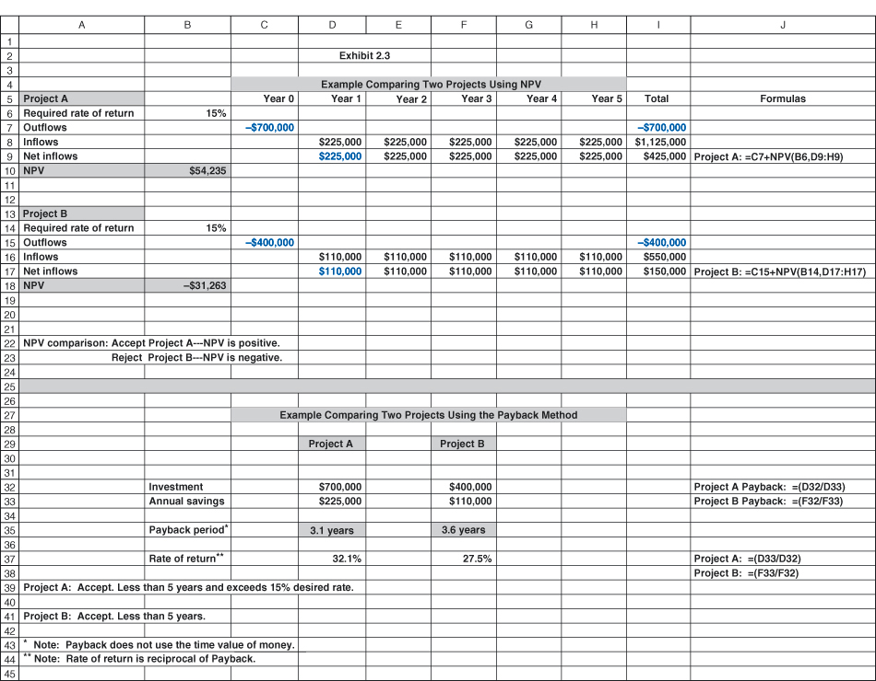
Net Present Value (NPV) and Internal Rate of Return (IRR):
Example Comparing Two Projects
EXHIBIT 2.3

Slide 15
Nonfinancial Criteria
To capture larger market share
To make it difficult for competitors to enter the market
To develop an enabler product
To develop core technology that will be used in next-generation products
To reduce dependency on unreliable suppliers
To prevent government intervention and regulation

Slide 16
Checklist Selection Model
Strategy alignment: What specific organization does this project align with?
Driver: What business problem does the project solve?
Success metrics: How will we measure success?
Sponsorship: Who is the project sponsor?
Risk: What is the impact of not doing this project?
Risk: What is the project risk to our organization?
Benefits: What is the value of the project to this organization?
Organization culture: Is our organization culture right for this type of project?
Approach: Will we build or buy?
Training/resources: Will staff training be required?
Finance: What is estimated cost of the project?
Portfolio: How does the project interact with current projects?

Slide 17
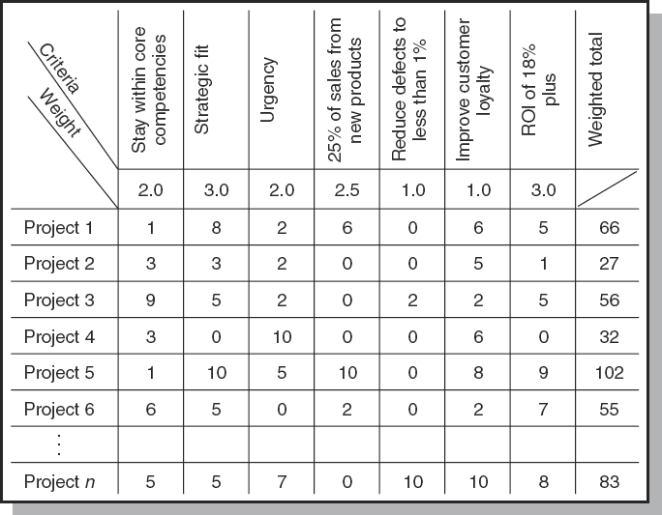
Project Screening Matrix
FIGURE 2.3

Slide 18
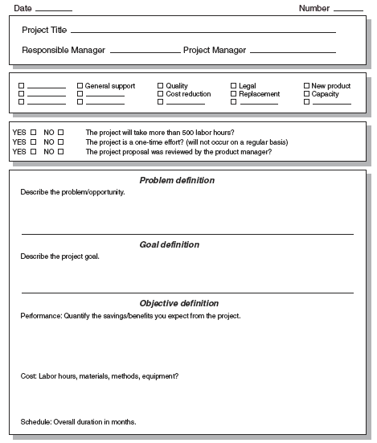
Major Project Proposal
FIGURE 2.4A

Slide 19
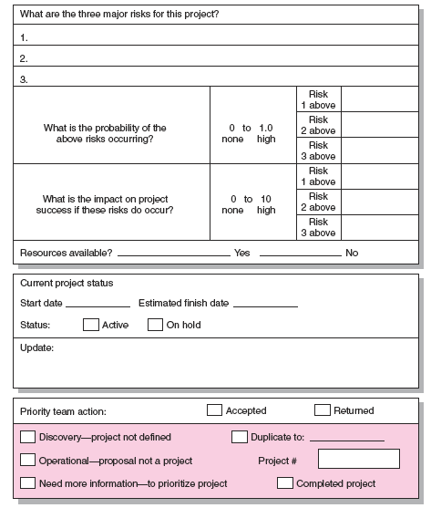
Risk
Analysis
FIGURE 2.4B

